Slide 1
Foodstuffs Inventory Management and Recipe System
Group 4 (Andrew, Fardin, Zifeng, Bryan, Braedon, Evan)

Slide 2
Overview
01
02
03
04
05
06
Introduction
Appealing Features
Major Challenges
Solutions
Lessons Learnt
Summary

Slide 3
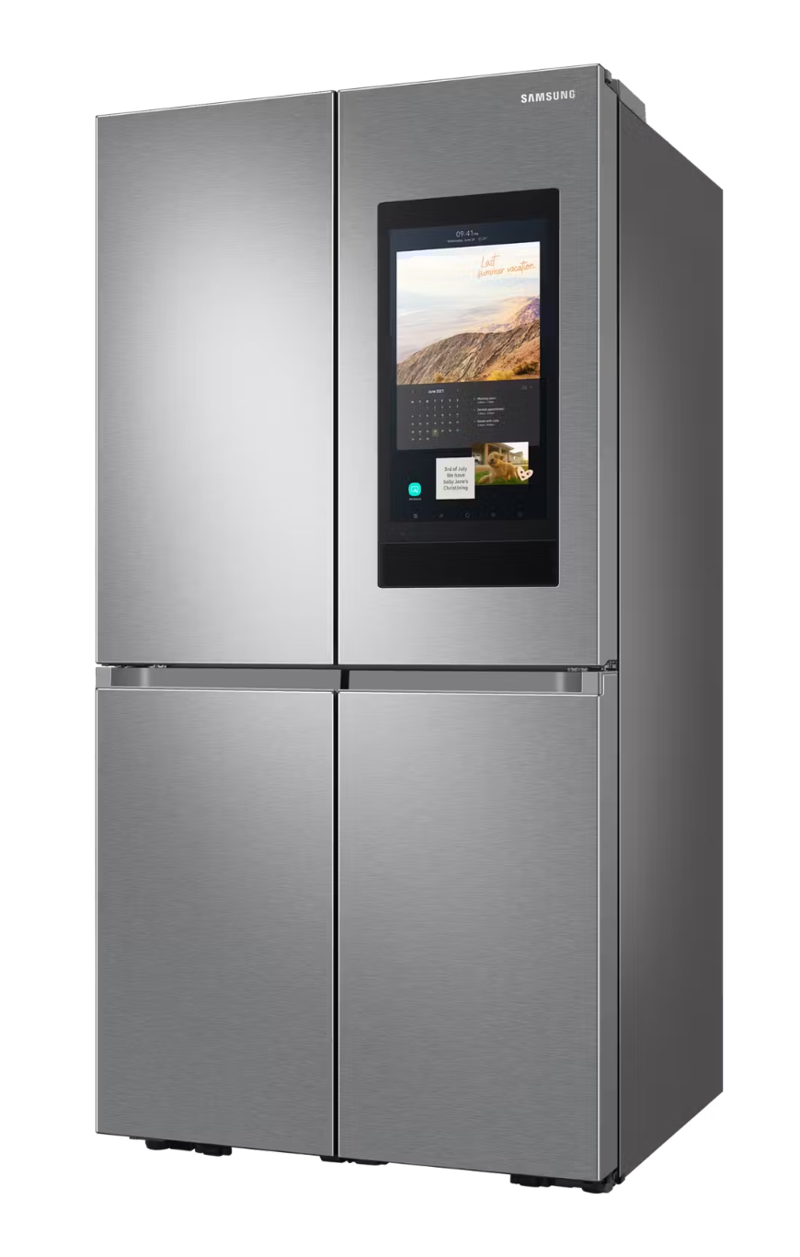
Introduction
An application that aims to assist people with Dietary Problems, Concerns, and/or Goals, as well as assist people with neurological disorders like Attention-deficit/hyperactivity disorder (ADHD) in meal planning, cooking, and shopping. The app will be designed for use on a mobile device or on a smart fridge screen.
Common challenges caused by ADHD while cooking:
Hyper-focusing on perfecting one step while neglecting everything else
Managing different cooking times simultaneously
Being distracted by kitchen clutter

Slide 4
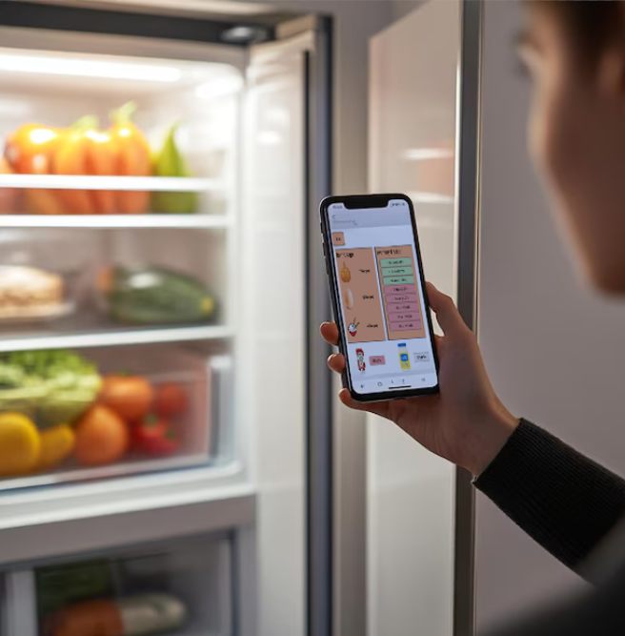
Appealing Features
Syncing Across Devices
Since Foodstuffs syncs with an online database, users can use any devices to access and modify information.
This allows for an adaptable platform that can be used anywhere, not exclusively on a smart fridge.

Slide 5
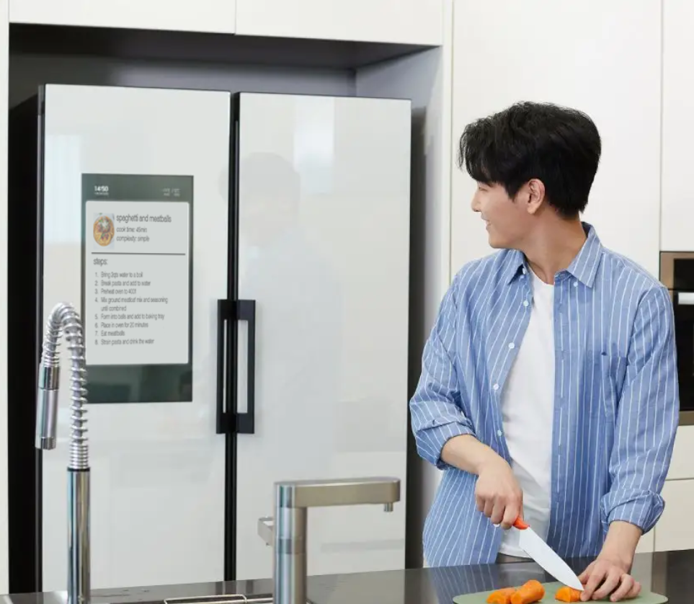
Appealing Features
Ease of Use
After setup, Foodstuffs allows for quick and easy actions that help improve the users cooking experience. Having notes about how much time till your products expire, or having a recipe displayed while cooking allows for a intuitive workflow between cooking, and accessing the app.

Slide 6
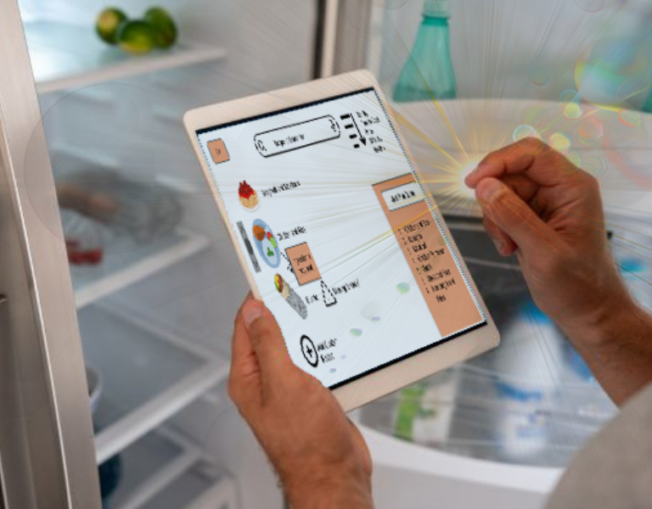
Appealing Features
Intuitive Scheduling
The meal plan queue system takes the stress out of meal planning by suggesting recipes and meals tailored to the ingredients you already have.
Designed with users that have ADHD, this feature streamlines decision-making and ensures no ingredient goes to waste.

Slide 7
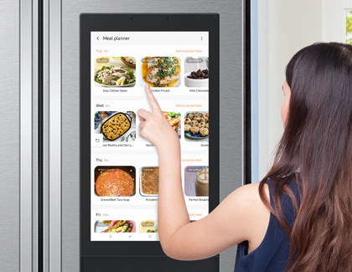
Major Challenges
Product Tracking
Simplification
API usage can both complicate and simplify user
Abstraction: Direct vs Indirect Inventory/Recipes Controls
Tedious Operations Burden the User
Complicated Operational Flow
UI Decision Making - “How do people actually shop, eat, and cook?”
Many Reasons to Modify Inventory
Various types of products with vastly different parameters
Incomplete Understanding of User Intentions and Habits

Slide 8

Solutions
Product Tracking
Barcode Scanning
Foodstuffs allow users to scan the barcode on grocery items to automatically add products
Recipe Tracking
Foodstuffs keeps track of recipes the user completed and deducts products accordingly
Manual Inputs
Foodstuffs allows user to manually update individual product usage to account for untracked usages

Slide 9
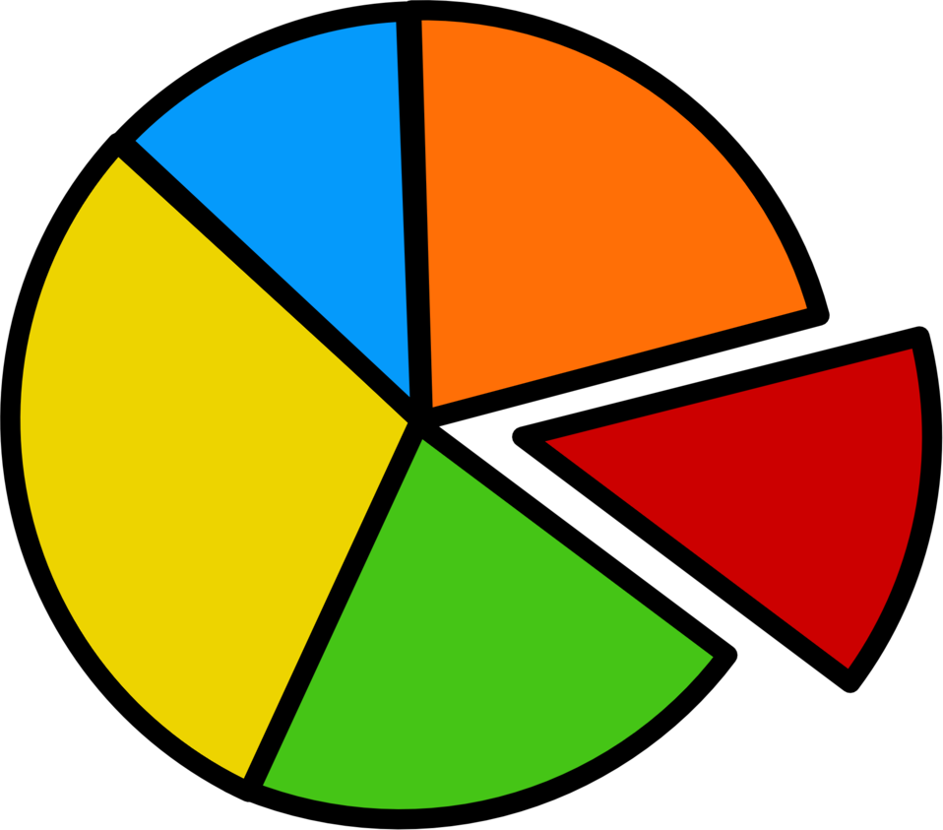
Solutions
Simplification
Online Recipe APIs
Foodstuffs allows users to pulls from online recipe databases through the usage of APIs
Intuitive Recipe Creator
Foodstuffs uses intuitive UI found in other document editing softwares
Weekly Reports
Foodstuffs generates weekly eating and spending reports as feedback for users to recognize their habits and patterns

Slide 10
Lessons Learnt
Teamwork Related Lessons
Define and understand roles
Meet deadlines early
Use team member’s strengths
Project Related Lessons
Be creative but to a limited extent
Sometimes less is more
Think from a user perspective
Assign one person to each system

Slide 11
Summary
Mission
Simplify meal planning and cooking for individuals with dietary needs and neurological challenges
Key features
Cross-device syncing
Ease of use
Intuitive scheduling
Overcame challenges
Product Tracking
Simplification
Learned
Team skills
User needs

Slide 12
Thank You!

